Slide 1
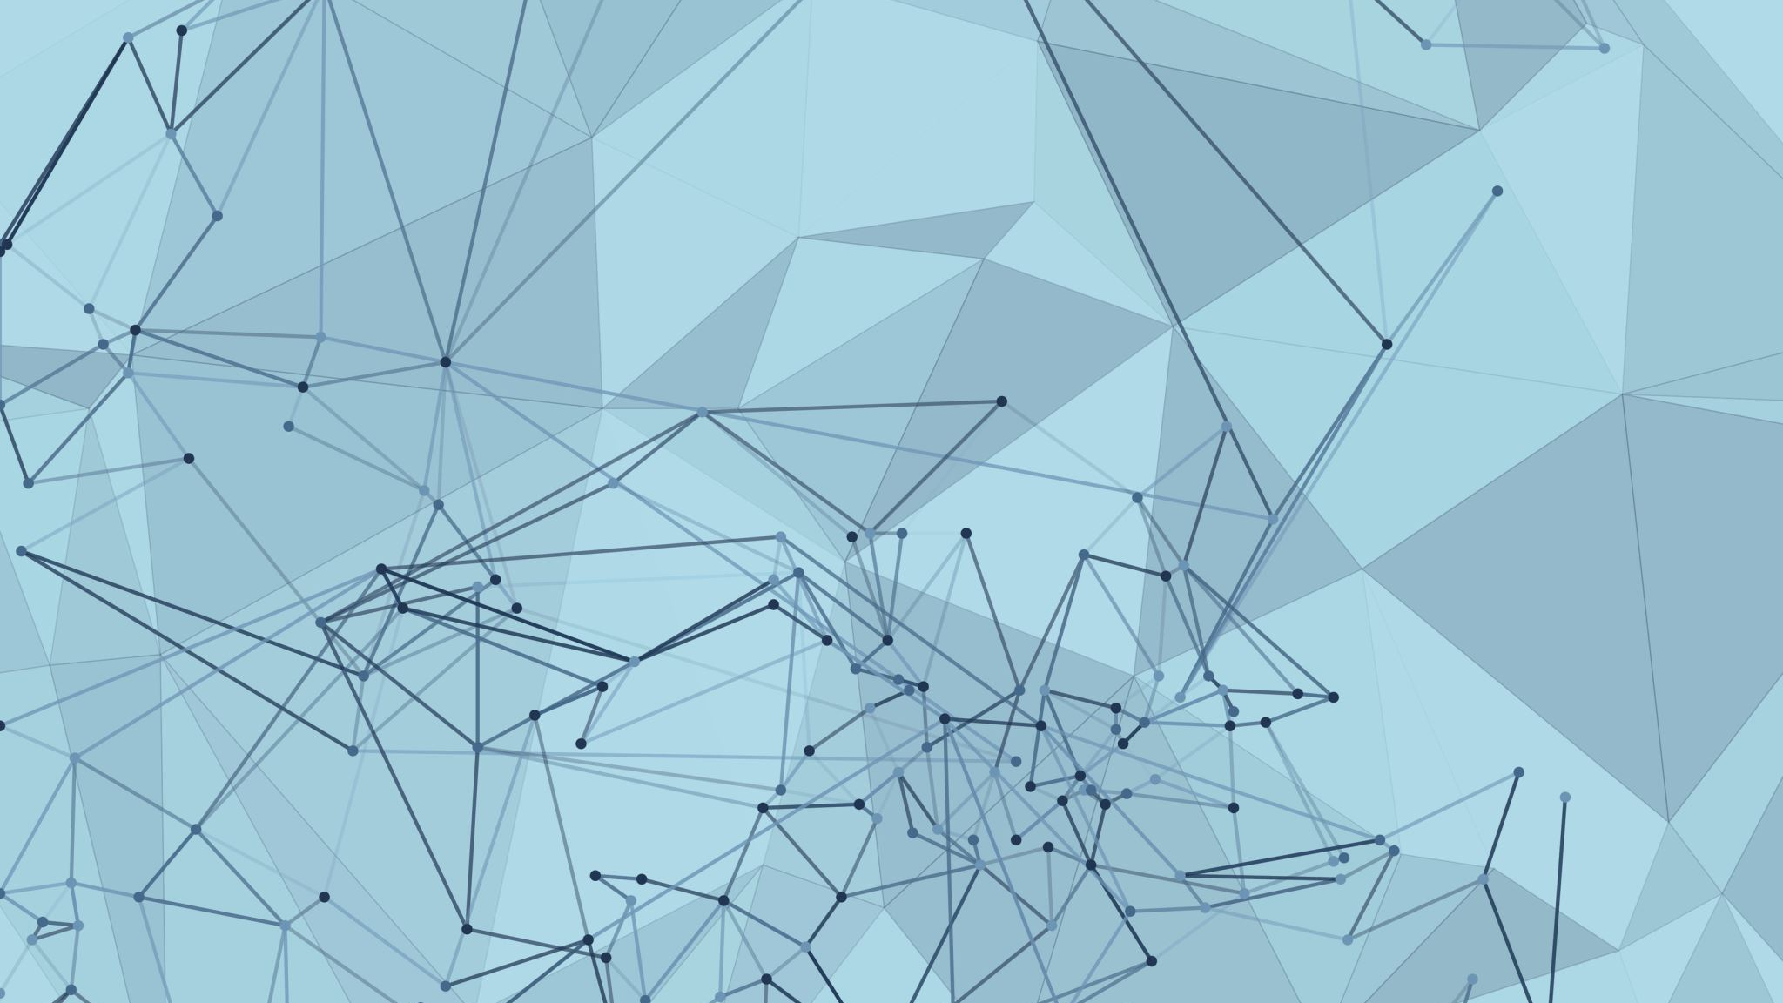

Comparative Analysis of Optical Flow Techniques: Classical Computer Vision vs Deep Learning Approach
C
Authors:
Arun Madhusudhanan
Francis Jacob Kalliath
Hardik Devrangadi
Tejaswini Dilip Deore

Slide 2
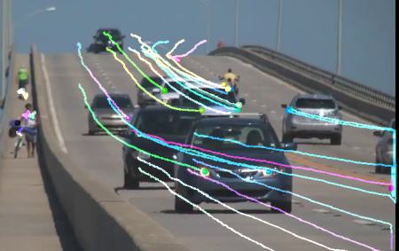
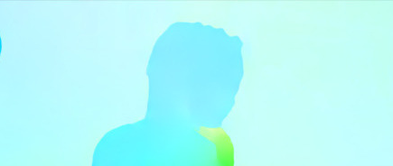
InTRODUCTION
Optical Flow of an image is the velocity field that represents the motion of the data at each pixel.
Provides an approximation to knowing how the objects in the image are moving.
Sparse Optical Flow : Describes the flow vector for some image features (edges, corners)
Approaches : Lucas-Kanade Algorithm.
Dense Optical Flow : Computes the flow vectors of all pixels from the image.
Approaches : Farnebäck, FlowNet.
Sparse optical flow
Dense optical flow

Slide 3
RELATED WORK
FARNEBACK:
Create a pyramid of images, where each level has a lower resolution than the previous level.
Track the motion of each pixel in the image pyramid, starting at the lowest level and working its way up to the highest level.
Combine the optical flow fields from each level of the pyramid to create the final optical flow field.
FLOWNET
The architecture consists of two branches that process the two input images separately to extract features, which are then matched between the two images using a correlation layer.
The estimated optical flow field is computed from the correlation map, and one image is warped to match the other using the flow field.
A refinement network is used to improve the accuracy of the optical flow field.
FLOWNET 2.0
FlowNet 2.0 has improved accuracy and efficiency compared to the original FlowNet.
FlowNet 2.0 uses a two-stage training process to learn general and specific features.
It utilizes an iterative architecture to learn complex relationships between two images.
To improve accuracy for small displacements, it uses techniques such as modifying the network architecture and fusing outputs from networks trained on different displacement datasets.

Slide 4
Scope OF THE PROJECT
Estimate optical flow on an MPI Sintel dataset using Farneback Algorithm and FlowNet2 mode.
Compare the performance of both approaches using performance metric.
Implement optical flow for face tracking:
Detect a face and put a bounding box around it using the Harr- Cascade Classifier on the first frame.
Estimate optical flow inside the bounding box and predict the bounding box in the next frame.
Use the bounding box detected by Harr-Cascade Classifier on all frames as ground truth
Measure the performance by the percentage of overlap between the optical flow tracked box and the face tracked box.
Implement optical flow for velocity estimation and movement direction
Performance metric:
L1 error: Average of the absolute differences between the estimated and ground truth optical flow vectors at each pixel.
Average End Point Error (EPE): Average of the Euclidean distances between the estimated and the ground truth optical flow at each pixel.
Average Angular Error (AAE): Average of the angles between the estimated and the ground truth optical flow at each pixel.

Slide 5
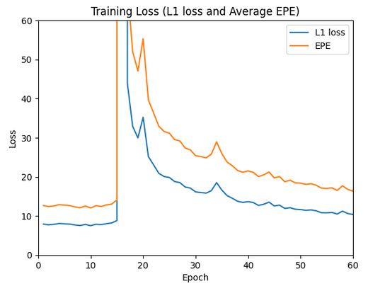
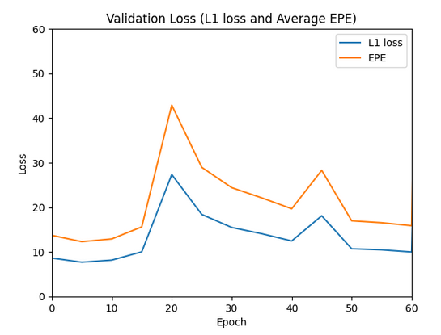
RESULTS : FLOWNET 2.0
Dataset used : Derived from MPI Sintel Flow Dataset.
Training data (Sintel Final) : 23 categories, total : 744
Validation data (Sintel Clean) : 23 categories, total : 744
Testing data (Sintel Final) : 23 categories, total : 320
Training is done on Google Colab.
Losses were not reducing after 60 epochs (Colab limitations)
Planned to use the available pretrained weights for further analysis.
Training Error
Model | Trained From Scratch | Pre-trained model
No of epochs: | 60 | 10000
Loss : | Average End Point Error
Batch Size: | 8
Optimizer: | Adam
Training Parameters
Validation Error

Slide 6
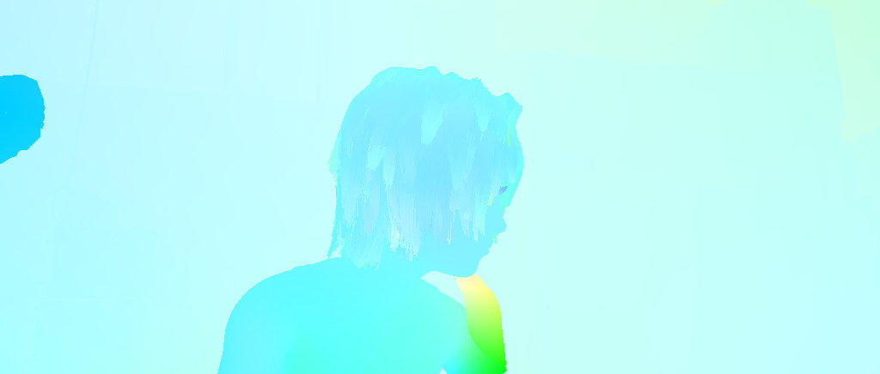
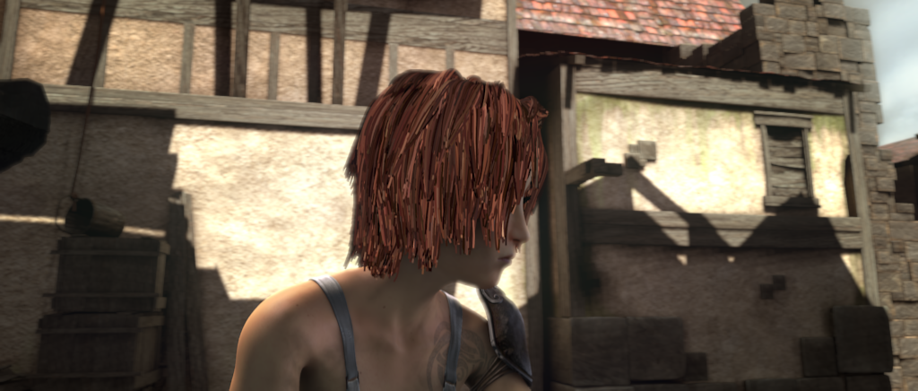
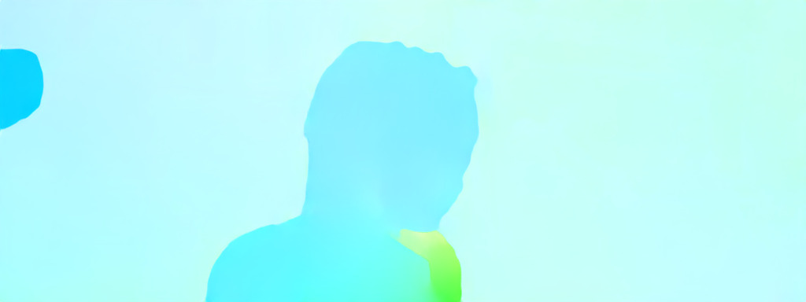

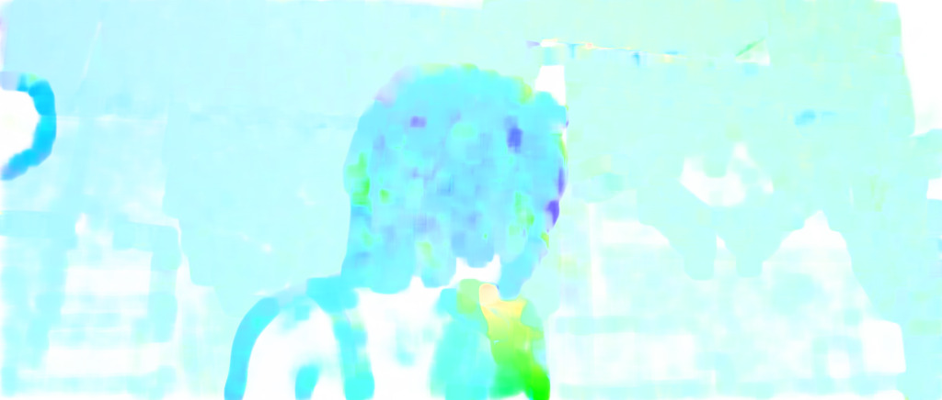
RESULTS : CompARISON
Ground Truth
Alley_1 : Frame_0035
FlowNet2
Farneback
Alley_1 : Frame_0036
https://youtu.be/S2ito1zSUEk
Optical Flow Results

Slide 7
RESULTS : CompARISON
Category | L1 Error |  | Average End Point Error (EPE) |  | AAE
 | Farneback | FlowNet2 | Farneback | FlowNet2 | Farneback | FlowNet2
Alley_1 | 0.6416 | 0.0924 | 23.6546 | 0.1476 | 31.0392 | 2.2396
Alley_2 | 1.5901 | 0.1524 | 56.9127 | 0.2445 | 27.4461 | 2.2787
Ambush_2 | 38.9716 | 1.2146 | 882.3624 | 2.2024 | 78.4506 | 2.6711
Ambush_4 | 14.7739 | 1.5013 | 426.9432 | 2.5994 | 74.6500 | 3.4777
Ambush_5 | 26.4725 | 2.3284 | 689.7455 | 3.8740 | 75.3315 | 4.3254
Ambush_6 | 34.6250 | 2.0365 | 865.6840 | 3.3719 | 73.8862 | 5.1622
Ambush_7 | 5.3257 | 1.7847 | 164.3199 | 2.9512 | 73.0746 | 5.0952
Bamboo_1 | 0.5527 | 1.6738 | 24.9192 | 2.7517 | 27.2078 | 5.2876
Bamboo_2 | 2.8247 | 1.5164 | 117.2136 | 2.4906 | 61.4336 | 5.6894
Bandage_1 | 0.5896 | 1.4095 | 23.6486 | 2.3147 | 36.0795 | 6.2677
Bandage_2 | 0.2237 | 1.3756 | 8.7772 | 2.2529 | 34.6466 | 6.1733
Cave_2 | 14.0825 | 1.3351 | 336.8272 | 2.1813 | 49.0335 | 6.0147
Cave_4 | 10.7466 | 1.4874 | 300.5732 | 2.4141 | 59.0035 | 6.4774
Market_2 | 0.1977 | 1.4268 | 9.4361 | 2.3152 | 53.6362 | 7.0750
Market_5 | 13.9899 | 1.4077 | 386.5746 | 2.2801 | 71.4026 | 7.0595
Market_6 | 5.7798 | 1.4447 | 186.9603 | 2.3299 | 61.3453 | 7.0261
Mountain_1 | 1.4578 | 1.3892 | 44.0406 | 2.2385 | 46.2691 | 6.8608
Shaman_2 | 0.1783 | 1.3163 | 6.2656 | 2.1207 | 27.7953 | 6.7706
Shaman_3 | 1.8477 | 1.2461 | 45.7262 | 2.0076 | 62.2367 | 6.7328
Sleeping_1 | 0.9926 | 1.1840 | 29.7839 | 1.9071 | 38.7935 | 6.5560
Sleeping_2 | 0.5207 | 1.1261 | 18.2515 | 1.8139 | 24.3843 | 6.3979
Temple_2 | 1.3428 | 1.0776 | 45.7841 | 1.7365 | 32.9923 | 6.2335
Temple_3 | 37.5473 | 1.1768 | 905.8085 | 1.8953 | 79.8069 | 6.1366
Mean | 9.3598 | 1.3349 | 243.4875 | 2.1931 | 52.1715 | 5.5656
The error values obtained for FlowNet 2.0 is very less compared to that of Farneback Algorithm.
The EPE obtained for FlowNet 2.0 is comparable to claimed by Authors ( 3.14).
The better performance here might be due to decreased number of test data
Comparison of error values

Slide 8
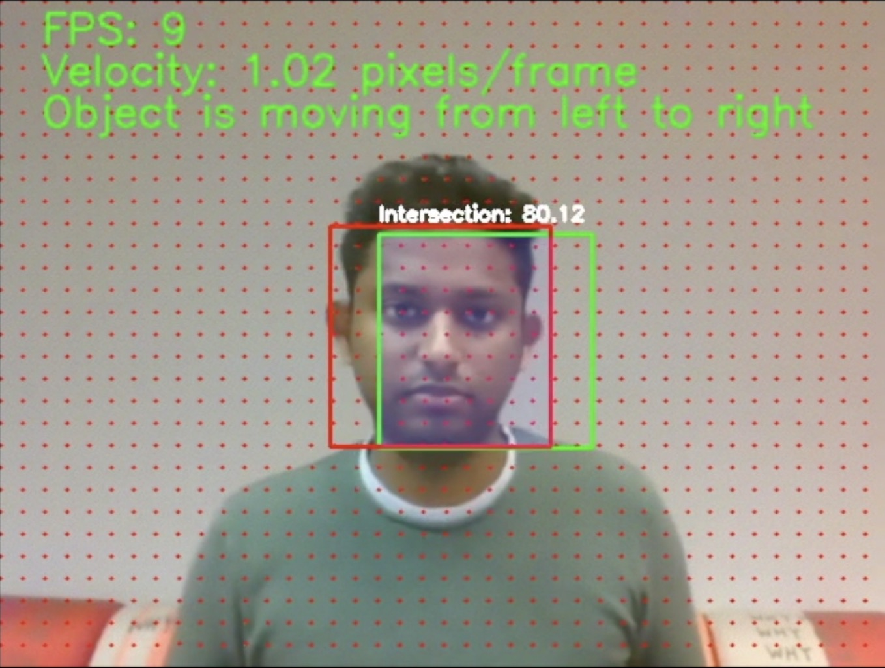
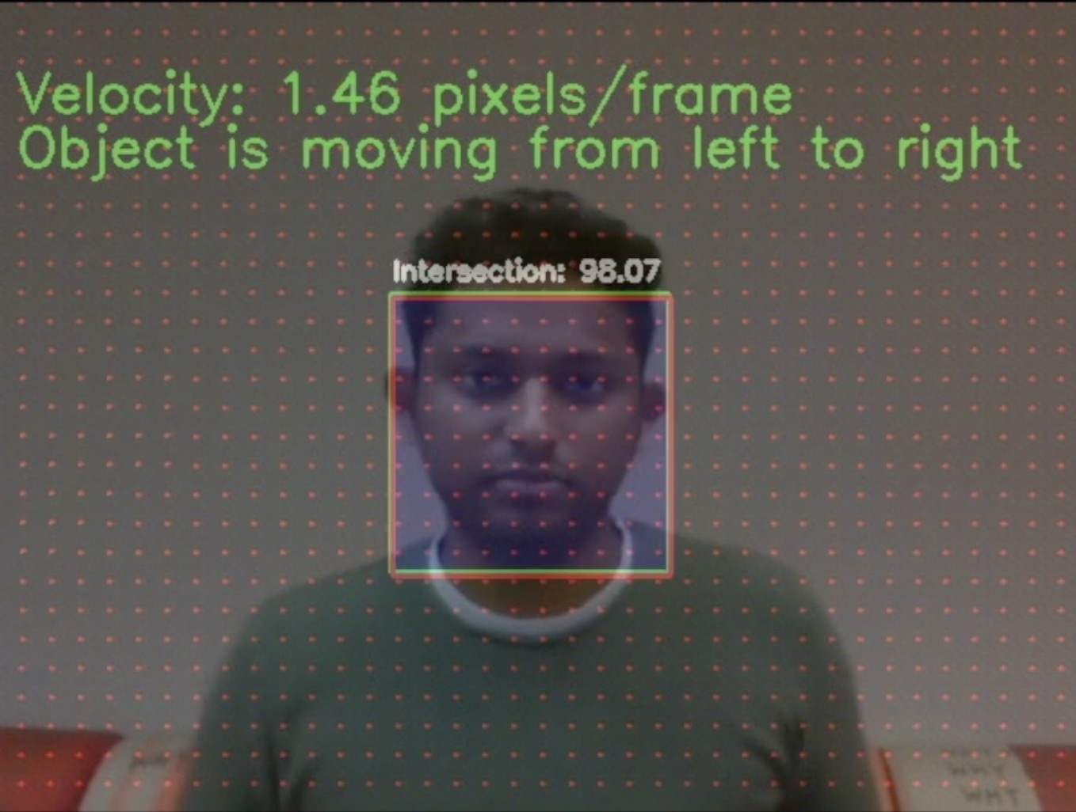
RESULTS : Implementation
The optical flow is obtained from both approaches, the mean flow in the ROI of each frame is calculated for tracking.
Green Bounding Box : Tracking using optical flow fields generated by Classical Computer Vision and Deep Learning Model
Red Bounding Box: Tracking face using Harr-Cascade Classifier on all frames, which is used as the ground truth.
The optical flow obtained is also used for determining the velocity and movement direction
Classical Computer Vision
Deep Learning
https://youtu.be/YQDdv9CqYyA
https://youtu.be/aHbXsap42-c
https://youtu.be/kpLF2yQc9fU

Slide 9
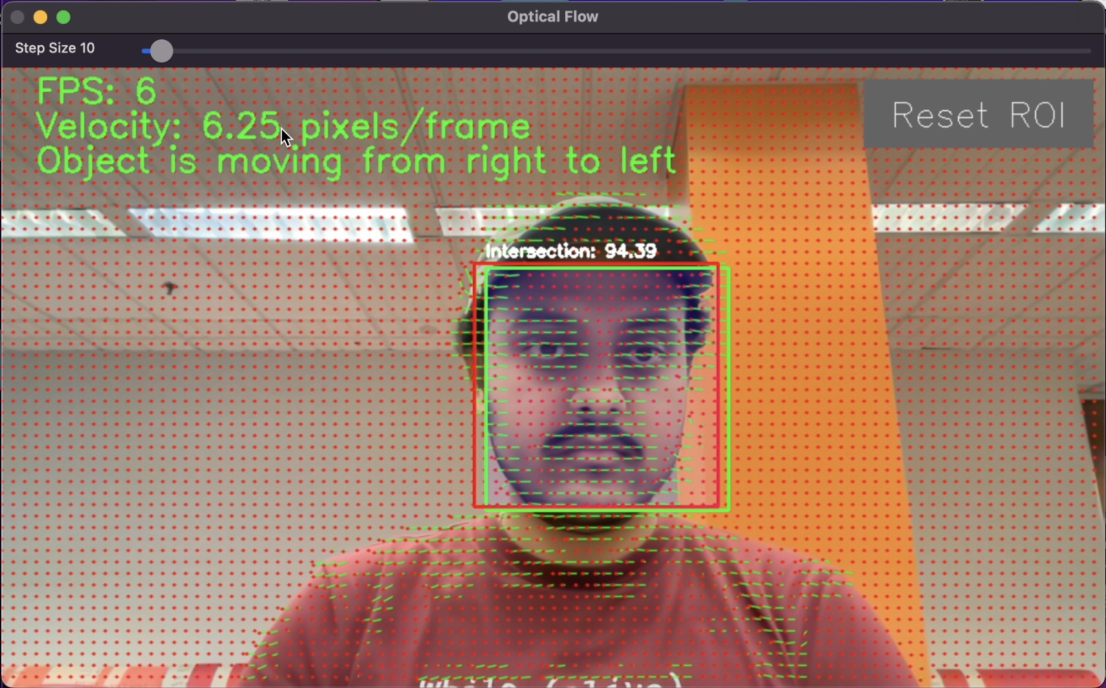
RESULTS : TRacking
When calculating the optical flow (Classical Computer Vision) on a live stream from a webcam, additional features have been added
Trackbar - A slider present on top of the image to vary the step size (the number of flow points) from 10 to 64.
Reset ROI - When this button is pressed, the ROI automatically resets to the tracked face.
https://youtu.be/nelAh5yYat4

